Slide 1
American Literature
Student’s Name
Institutional Affiliation
Notes:
This presentation discusses the contribution of Edgar Allan Poe to the American literature through his works such as poems, short stories and criticizing of magazines.

Slide 2
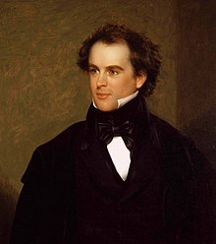
Introduction
Edgar Allan Poe comes out as a distinguished writer
From criticizing magazines, writing short stories and poems made his work unique
Notes:
Edgar Allan Poe comes out as a distinguished writer from the work he did during his time. From criticizing magazines to writing of short stories and poems made his work unique and thus contributing much to the America literature. Criticizing magazines was one of the works that made him known all over America and beyond.

Slide 3
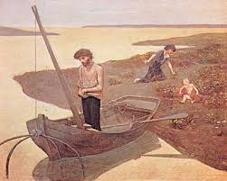
Contribution During the Romantic Era
Commanding language which inspired imagination and originality (Tonkin 18)
Felt by the French symbolists in the late 19th century using gothic mode (Morgan 75)
Notes:
Edgar Allan Poe contribution during the romantic era was great. He used a commanding language which inspired imagination and originality (Tonkin 18). Through this he was able to influence scholars way of thinking and how they are supposed to present their information through writing. Such influence was felt by the French symbolists in the late 19th century while at the same time using gothic mode to achieve a certain fiction attributes (Morgan 75).

Slide 4
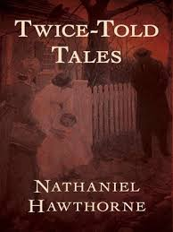
Influence on Literary Magazines
Edgar style and structure influenced literary magazines (Reese 82)
For instance, in Nathaniel Hawthorne's 'twice told tales' his much emphasis on structure and style (Unrue 115)
Notes:
Concentrating on style and structure Edgar Allan Poe influenced literary magazines during his time (Reese 82).
For instance, in Nathaniel Hawthorne's 'twice told tales' his much emphasis on structure and style prompted various scholars to start criticizing magazines (Unrue 115).

Slide 5
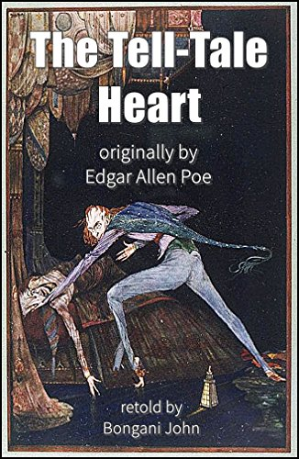
Contribution to Short Stories
Edgar Allan Poe used horror and detective fiction in short stories, for instance, The Tell-Tale Heart (Francis 170)
Notes:
Edgar Allan Poe helped come up with horror and detective fiction in short stories thus fictionalizing real events coming up with detective stories, The Tell-Tale Heart (Francis 170).
This leaved a landmark in terms of how authors are supposed to approach writing of short stories and the like.

Slide 6
Conclusion
Having discussed Edgar Allan Poe selected period and his significant contributions to American literature, it is evident that his contribution to the American literature are immeasurable
Many scholars were able to pull up their socks as far as writing of poems, short stories and criticizing literary magazines is concerned
Notes:
Having discussed Edgar Allan Poe selected period and his significant contributions to American literature, it is evident that his contribution to the American literature are immeasurable. Through his works many scholars were able to pull up their socks as far as writing of poems, short stories and criticizing literary magazines is concerned.

Slide 7
Works Cited
Francis, Roger A. "The Final Days of Edgar Allan Poe: Clues to an Old Mystery Using 21st Century Medical Science." OMEGA-Journal of Death and Dying 60.2 (2010): 165-173.
Morgan, Robert. "A Note on" A Tale of the Ragged Mountains" by Edgar Allan Poe." Appalachian Heritage 39.2 (2011): 75-75.
Reese, Sam. "Verbal Violence and Patterns of Words: Poe, Bowles, And an Alternative American Tradition." Poe Studies 46.1 (2013): 78-93.
Tonkin, Maggie. "The “Poe-etics” of Decomposition: Angela Carter's “The Cabinet of Edgar Allan Poe” and the Reading-Effect." Women's Studies 33.1 (2004): 1-21.
Unrue, Darlene Harbour. "Edgar Allan Poe: The Romantic as Classicist." International Journal of the Classical Tradition 1.4 (1995): 112- 119.

